Slide 1
WDI Country Population data
Daniel Clark

Slide 2
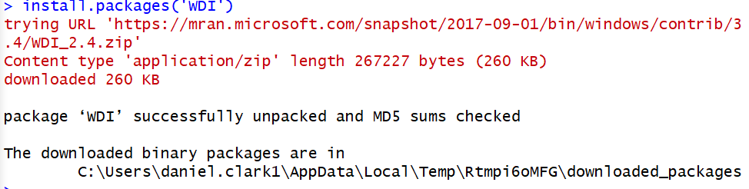
Install packages (WDI)
Installed package and downloaded library

Slide 3

WDI search and population indicator
> Coffeedata <- WDI(indicator="SP.POP.TOTL")
Searched population millions data and assigned it to a variable called coffee data.

Slide 4
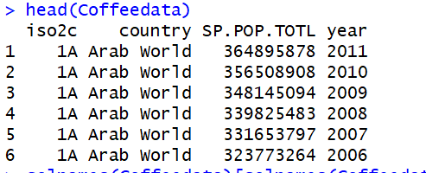
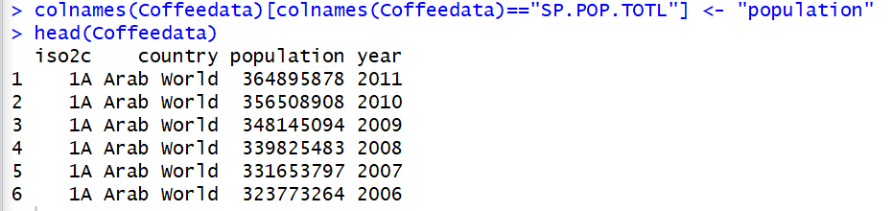
Changed column names
Took the original data
<<------
And changed the population header to "Population"
------>>

